Slide 1

Solutions in Action:
Counteracting Divisiveness
Office of Undergraduate Studies, Office of Diversity & Inclusion
Teaching & Learning Transformation Center & ADVANCE
June 21, 2017

Slide 2
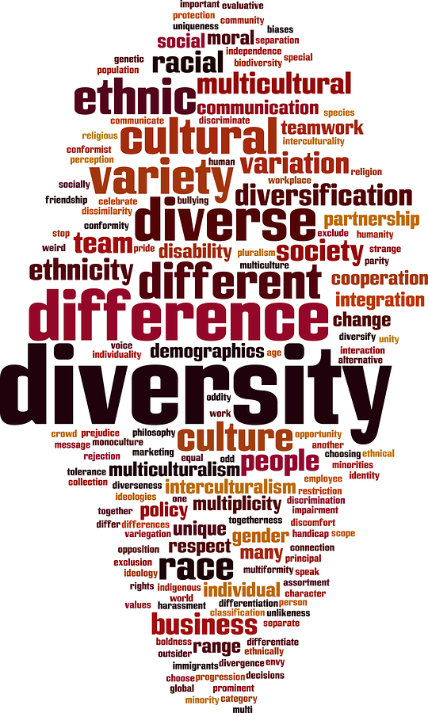
Welcome
Purpose & goals
  Honesty
  Understanding
  Active participation
  Agency
Upcoming sessions
  Wednesdays, June 28 - August 9
  We welcome volunteers for table discussion facilitation
Notes:
Cindy

Slide 3
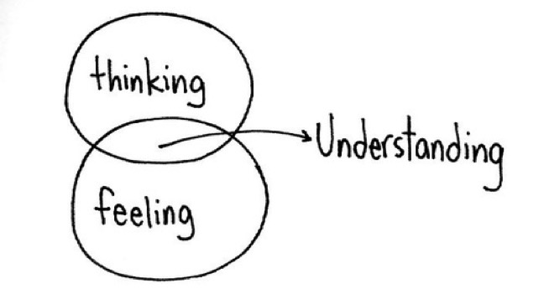
Proposed Community Agreements
Recognize that understanding is a journey
  Not a destination and we are all in process.
Speak from own experience
  “I” rather than “we,” “you” or “they”
  “As a person of color,” “As a white woman,”
  or “as a Vet”
Seek to broaden understanding
  Rather than to force agreement or harmony
  Thinking/Feeling
Recognize cultural & historical contexts
  Words, images & actions “land” differently
Discussion as a basis for action
Self-care
Notes:
Khalid

Slide 4
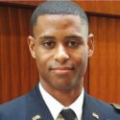
What’s Happening on Campus?
Violence: murder of LT Richard Collins III on May 20, 2017
White supremacist posters, 5 incidents since December 2016
Imagery: noose hanging in kitchen of Phi Kappa Tau in April 2017
Student tweets: #FearTheTurtle on May 22, 2017
#FearTheTurtle being the only black man on the floor of my freshman dorm gave a coward the courage to call me the n word through the walls
3:56 PM – 22 May 2017
when a UMPD officer whispered in my AfAm student's ear: "I could f&ckin' ruin your life right now if I wanted to." #FearTheTurtle
3:09 PM – 22 May 2017
UMD students constantly badmouth majority-minority Prince George's County as ghetto and dangerous. #FearTheTurtle
8:55 PM – 22 May 2017
my first week in college park a white kid told me at a party that obama was a monkey & that all black girls were ugly #FearTheTurtle
9:37 AM – 22 May 2017
Notes:
CindyTimea

Slide 5
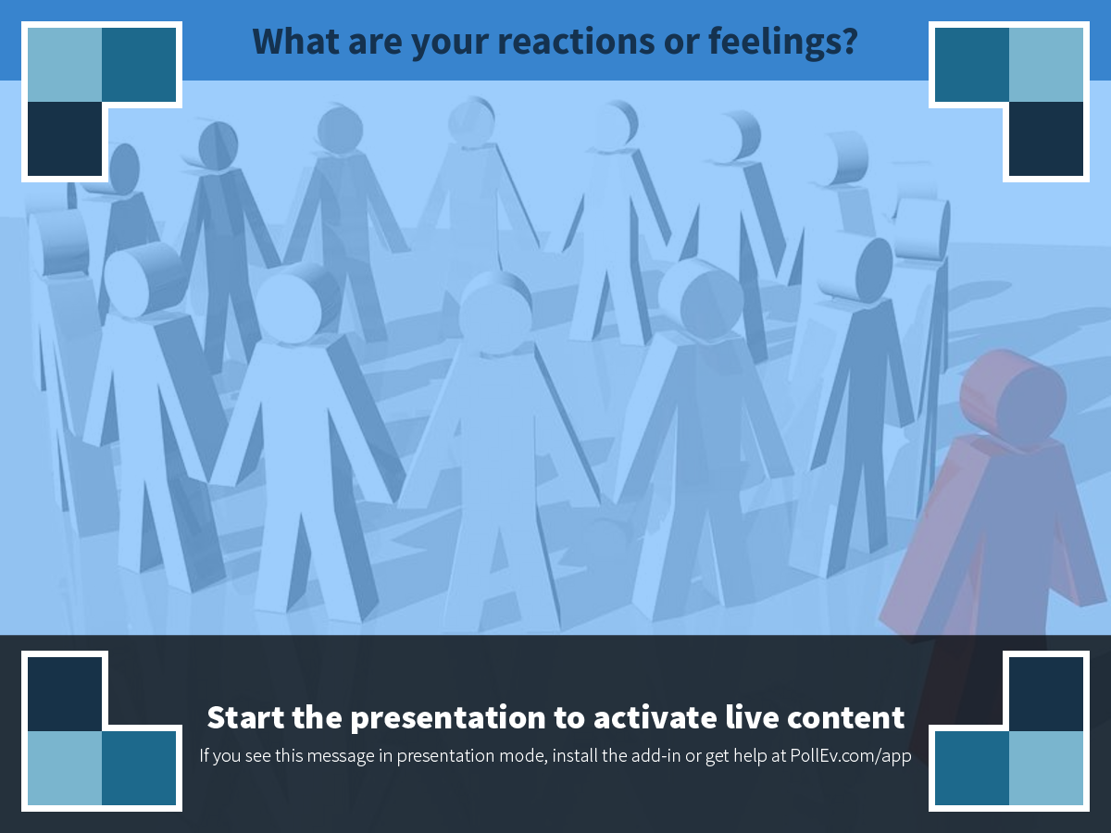
Notes:
Poll Title: What are your reactions or feelings?
https://www.polleverywhere.com/free_text_polls/0SRCIkQtoJVEoVI

Slide 6
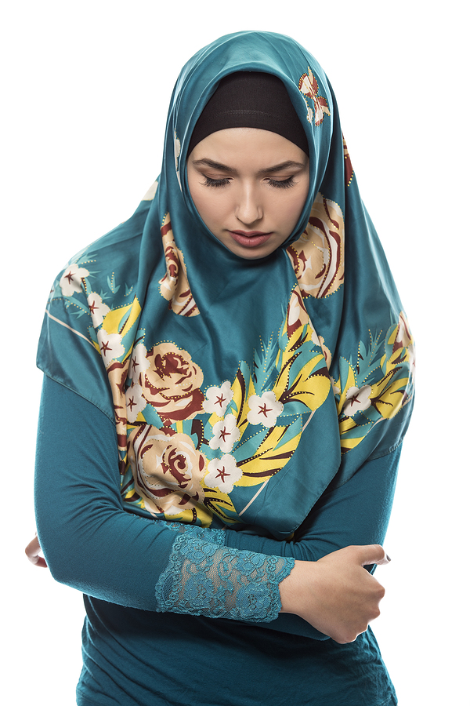
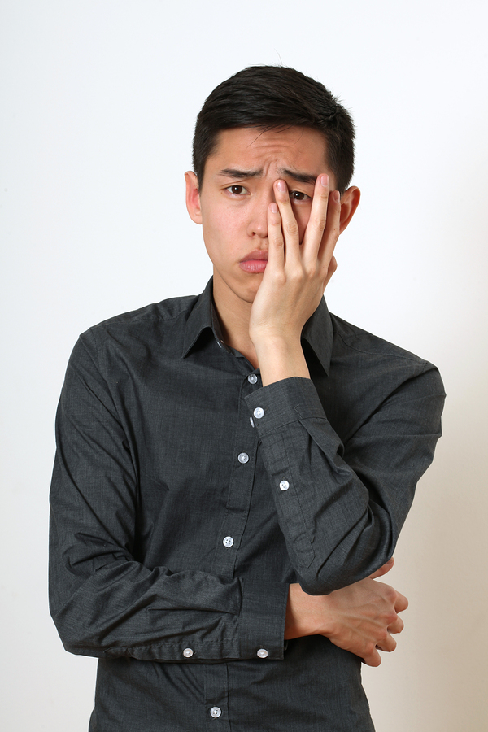

For table discussions…
What range of reactions is represented?
Which reactions are shared? Which are unique?
What can we learn from each others’ reactions?
Notes:
Timea
Think, pair, share

Slide 7
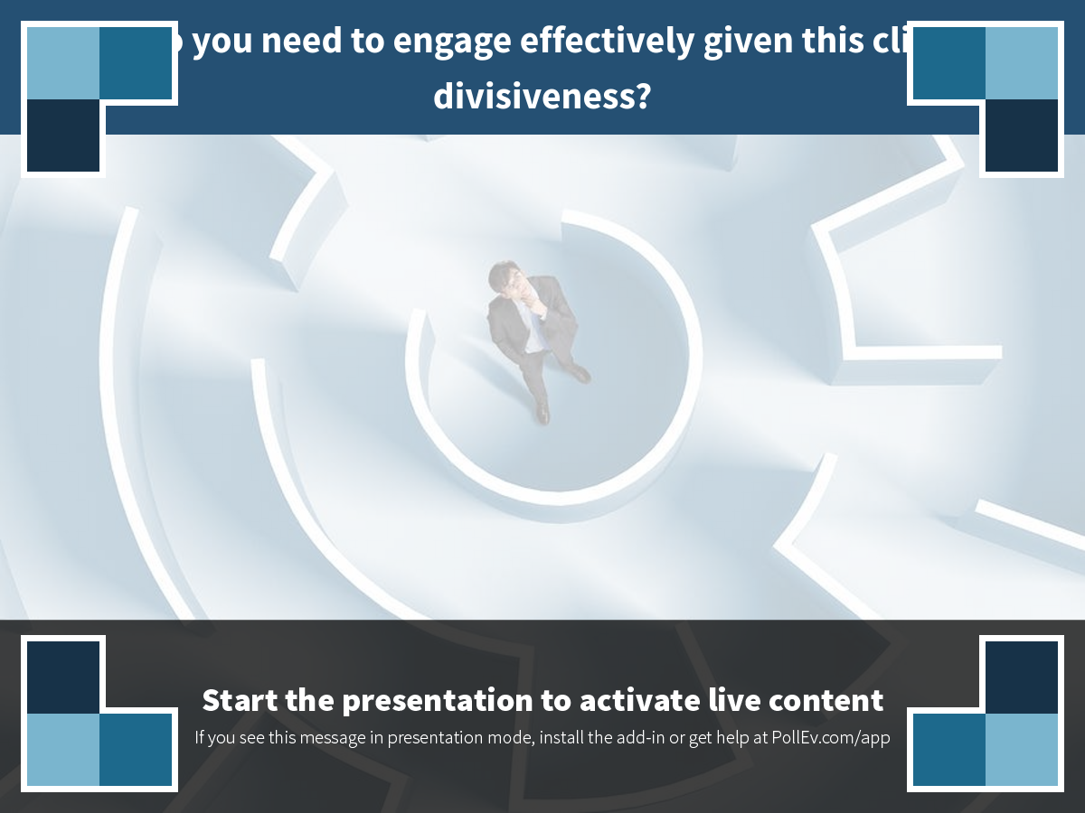
Notes:
Poll Title: What do you need to engage effectively given this climate of divisiveness?
https://www.polleverywhere.com/free_text_polls/Myh8uIgTFZhChrW

Slide 8
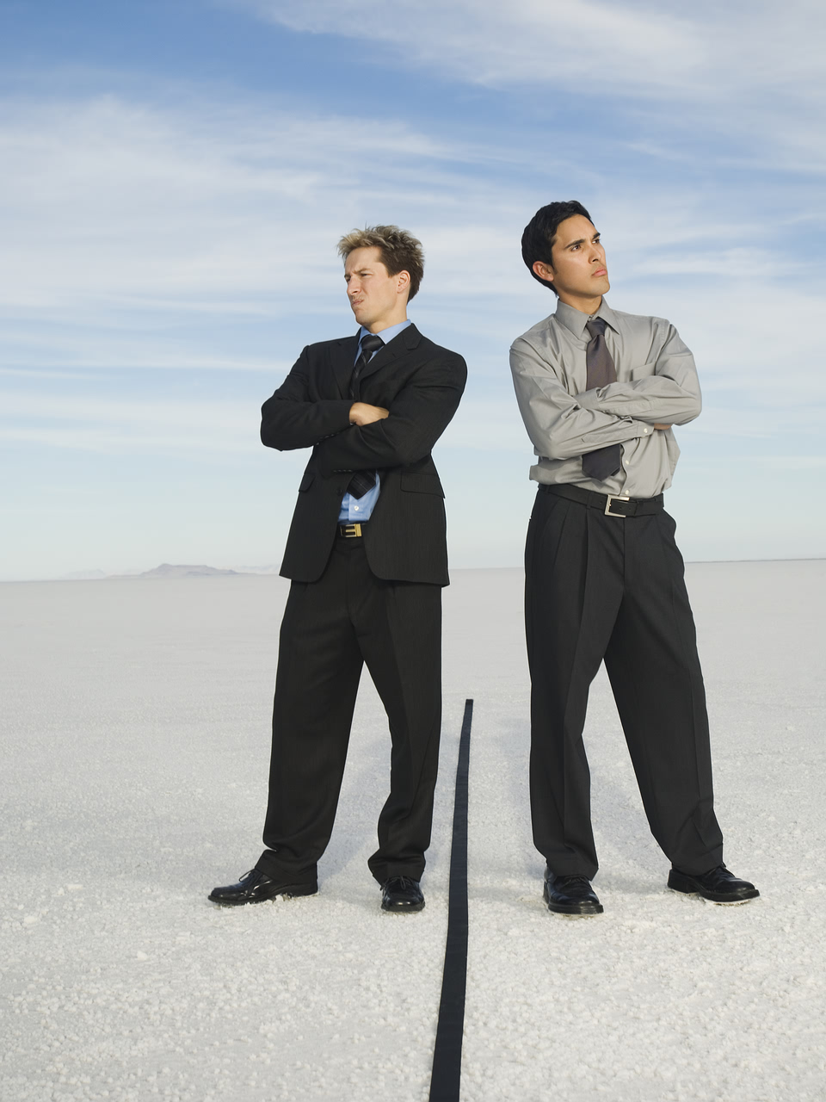
For table discussions…
What do you need to engage with others about these issues?
What do we need to do as a campus to communicate effectively given the divisiveness?
Notes:
Timea

Slide 9
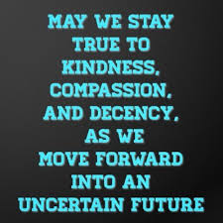
Wrap Up
A few moments of quiet reflection
Memorial stones & cards
Feedback
  https://marylandmarketing.qualtrics.com/jfe/form/SV_6hxv6hidKDDPyxn
Notes:
Cindy/Timea

Slide 10
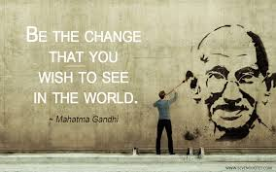
Notes:
Cindy

Slide 11
Resources
Office of Diversity and Inclusion (ODI)
Website: diversity.umd.edu
Email: diverseterps@umd.edu
University of Maryland Counseling Center
Website: counseling.umd.edu
Counseling Center Main Number: (301) 314-7651
After Hours Crisis Support: (301) 314-7651
University Health Center
Website: health.umd.edu
Telephone: 301.314.8180
Email: health@umd.edu

