Slide 1

Creating Institutional and Cultural Change
Faculty-Staff Brown Bag Sessions
Cindy Stevens & Donté McGuire
July 5, 2017
Notes:
Thank you joining us, our intent is to have a dialogue (not monologue) about organizational change.
Will be posing questions for discussion and using Poll Everywhere as in past.

Slide 2
Welcome
Check website for updates: www.ugst.umd.edu/solutionsinaction.html
Volunteers
Check-in
Notes:
Check website for future updates
These sessions are all volunteered

Slide 3

Session Goals
Identify your sources of power
Clarify brakes and gas pedals for change
Begin imagining possible action for change in your unit

Slide 4
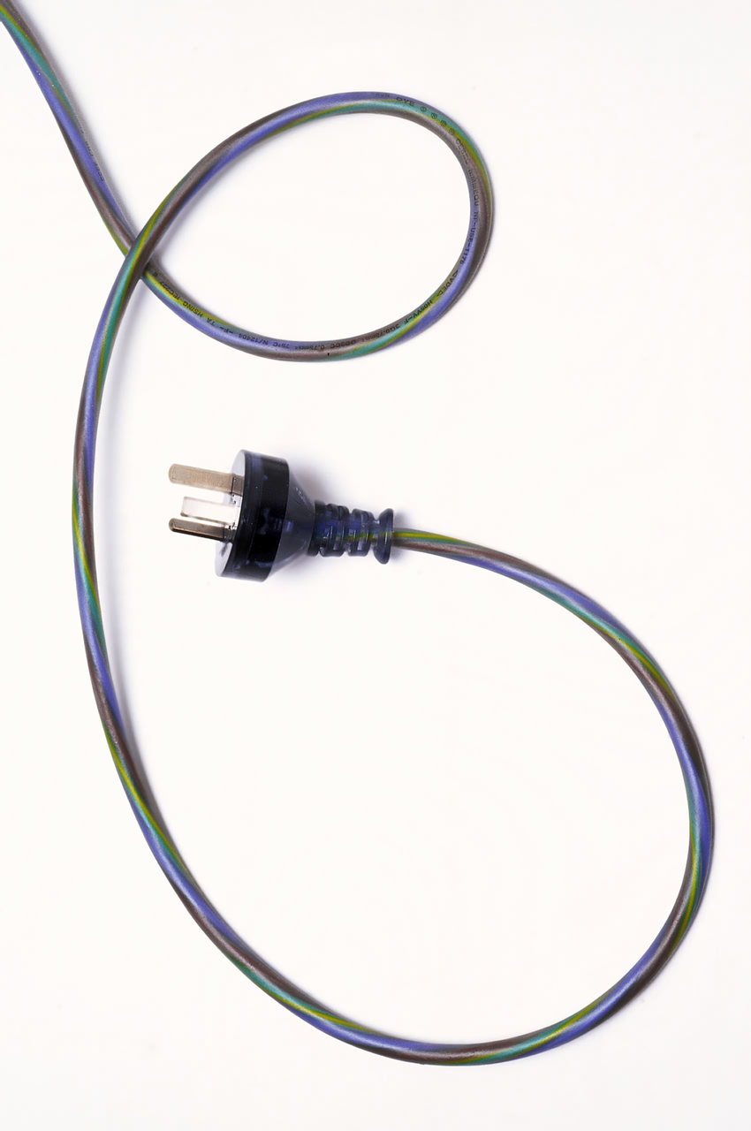
What is power?
Any resource you have that people value.
What are potential power resources?
Formal authority
Social network
Information or knowledge
Rewards and sanctions
Reputation
Others?
Notes:
Key issue that comes up has to do with POWER; assume that we need it in order to promote change.
What is power?
Any resource you have that others want.
What are potential power resources?
Formal authority: power that your organization gives you
Social network: quality of your ties with other people—who you know, where they are located
Information: your specialized knowledge or expertise
Organizational & unit norms: shared understanding about what is important or how things should be done
Other resources?
Reminiscent of last week’s discussion of identities:
Power is contextual (may not have hierarchical power at work, but do have hierarchical power over children at home).
It is relative: you may have power at work in supervising other people; those who supervise you have more power than you do at work.

Slide 5

Organizations are networks of people
They have different roles:
Decision makers: have power or authority to decide.
Influencers: offer advice & suggestions to decision makers.
Stakeholders: are directly or indirectly affected by changes.
Bystanders: are not directly affected by change but can observe and comment.
Each role has power!
Notes:
To get an organization to change, we have to get a critical mass of people to change.
We’ll have most success if we do this within NETWORKS, because people influence and affect each other.
EX: brown bag sessions
Decision makers: Bill, John Bertot, Ben Bederson, Provost
Influencers: me, others
Stakeholders: Students
Bystanders: press

Slide 6

What are your sources of power at work?
What resources do you have that other people value?
What could you do to increase your power to create change?
Notes:
Discuss with those near you:
What resources do you have at work that other people value?
How might you increase your power to create change?
Debrief:
We often have more power than we think we do; we just haven’t felt a need to exercise it.
With power comes responsibility to exercise it wisely & with care.
http://abcnews.go.com/GMA/video/young-man-poses-fake-celebrity-times-square-17066090

Slide 7
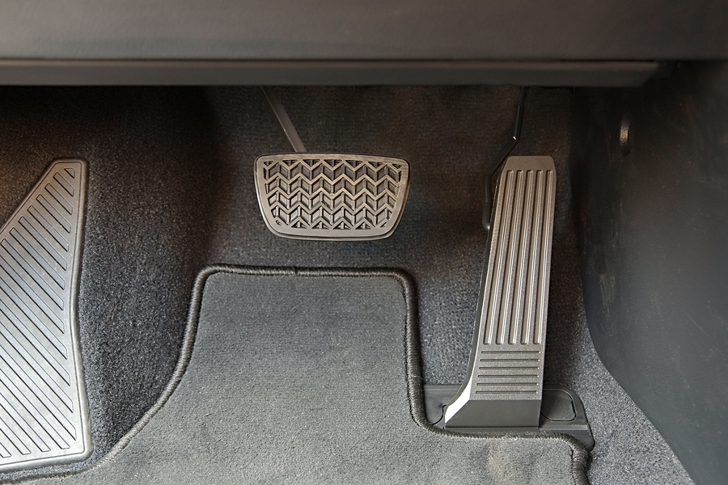
Gas pedals and brakes on change
Gas pedals
  Sense of urgency
  Interest among staff and faculty
  Student demands for change
  Other factors?
Some brakes
  UMD structure
  Culture of academe
  Uncertain vision of needed changes
Notes:
Helpful to clarify things that make it easier versus harder to create change.
We have some important “gas pedals” for creating change:
A sense of urgency: LT Collins’s murder shocked many, woke up many to critical need to do something differently.
We hoped for 20+ people at the first brown-bag; we have had well over 100 people attend.
Our students have been asking for change—they’ll be back in the fall demanding it.
Need also to understand factors that make it hard to change: structure, academic culture & need for a vision of what change should look like.

Slide 8
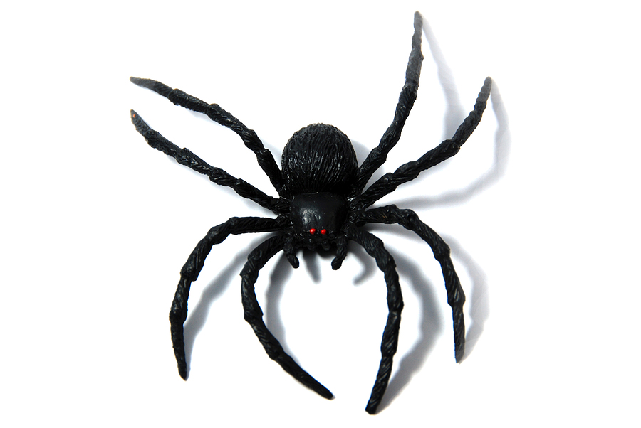
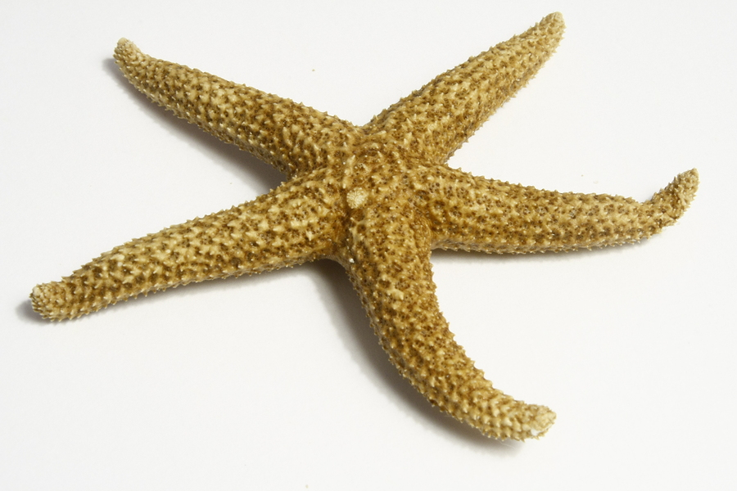
Spiders, starfish and organizations
How do spiders and starfish differ?
Starfish legs duplicate all their internal organs; if you cut one off, it grows back.
Decentralized organizations are like starfish—the units act independently. To create change, you have to change every unit.
Notes:
To understand how UMD’s structure affects its capacity to change, use example of spiders versus starfish. Both creatures with many legs, if you had never seen either one, might think they’re similar (multiple legs).
Key difference is in how they are constructed anatomically: if you cut off a spider’s leg, you get a 7-legged spider. If you cut off its head, it will die—it has a central nervous system with a single brain. However, starfish are quite different—all internal organs are present in all of its legs. If you cut off one leg, it will grow back. If you cut it in half, it can grow into two starfish

Slide 9
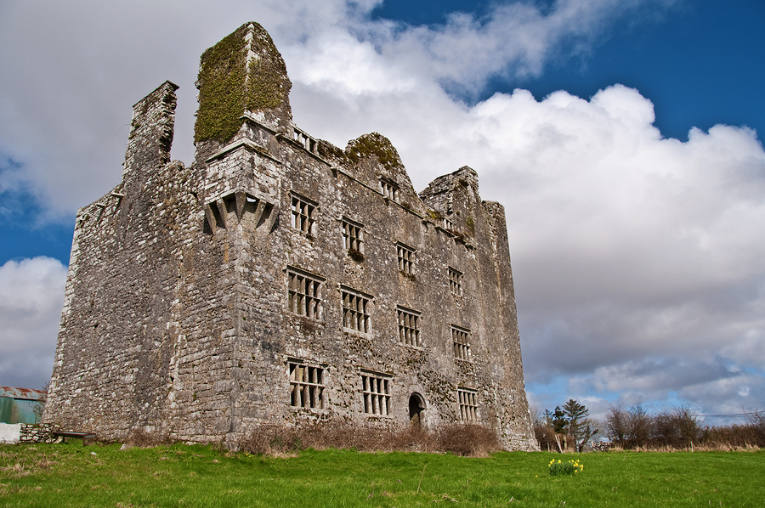
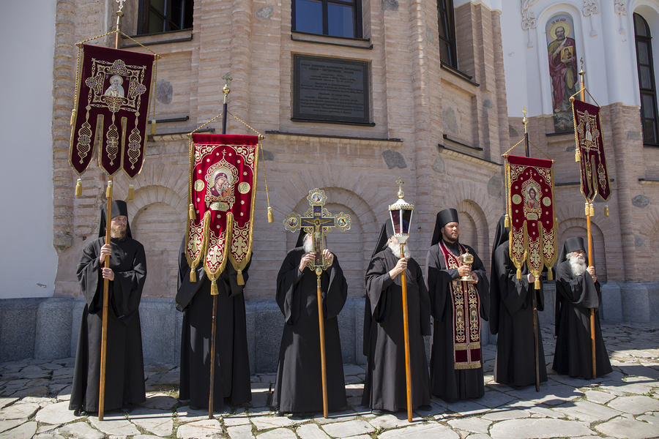
Culture of academe
Universities evolved from European monasteries
  Hierarchy/tradition run deep
  R1 faculty tend to focus on their disciplines
Ideas are more accepted when described in ways that “fit”
Notes:
What types of ideas fit the culture of academe?
Appeal to the intellect, make well-reasoned arguments
Evidence-based approaches, offering concrete evidence of approaches that work
Freedom of thought—it’s often better NOT to make things mandatory so that faculty choose to participate
Give faculty a chance to debate ideas thoroughly prior to adoption

Slide 10

Uncertain vision of change
All things are created twice: first mentally, then physically.
The key to creativity is to begin with the end in mind, with a vision and a blue print of the desired result.
Stephen Covey
(1932-2012)

Slide 11

Begin with the end in mind
What would be different if your unit fully welcomed & accepted people from all races and ethnicities?
Specifically, how would you know?

Slide 12

Small Group Discussion
In small groups, please discuss:
What 1-2 actions would your unit need to do/do differently?
How might those changes “fit” within the culture of academe & your unit?
Who would need to be involved? How could you enlist their help?
Notes:
12
June 21-24, 2010
(c)2010, Jeff Kudisch & Cynthia Stevens. All rights reserved.
Force 3: Developing the Next Generation of Leaders

Slide 13

Debrief Discussion
donte@terpmail.umd.edu
What ideas did you come up with?
If you email your ideas to us, we’ll combine and post them online.
cstevens@rhsmith.umd.edu
donte@terpmail.umd.edu
longky@terpmail.umd.edu

Slide 14
Steps to create organizational change
Create momentum--find early “wins”
Build on that momentum over time
Anchor changes in the structure & culture
Empower people to act on the vision
Communicate the vision
Develop a clear vision of change
Form group to push for change
Create a sense of urgency

Slide 15
